Slide 1
DAIKIN’s HOT GAS DEFROST
★ Principle
VAPOR
80℃
NON HEATED AIR
300 ～ 500 ℃
< HOT GAS >
< ELECTRIC HEATER >

Slide 2
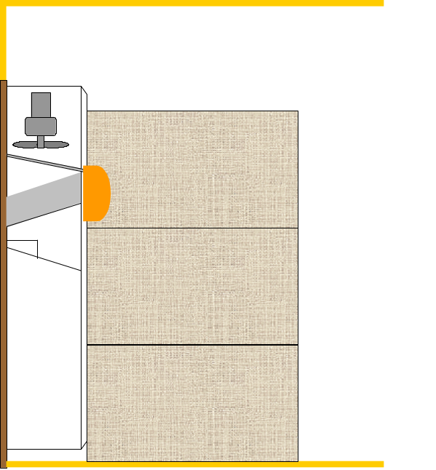
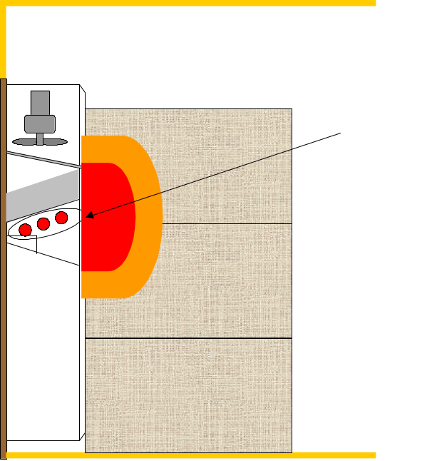
< HOT GAS >
< ELECTRIC HEATER >
Surface temperature
（Fin）
0～10℃ or lower
Wet Damage
Electric heater
Ice Cream Melts
Surface temperature
（Electric heater）
300～500℃
● Maintenance Free
● Megger check
● Replacement, every 4 years

Slide 3
WHEN IS DEFROST OPERATION PERFORMED ?
Short timer 4 Hr
Pull-down
Automatically
Quick pull-down defrost
Long timer 3,6,9,12,24,99Hr
In-Range
Manualy setting
On demand defrost
９９
Out-Range
Out range timer 30 min.
Automatically

Slide 4
DEFROST OPERATION ?
Defrost operation
[Termination Condition]
In-range at defrost initiation EOS>30 ℃
or 90 minute elapsed (E207)
Out-range at defrost initiation EOS>30 ℃ & RS/DRS>15 ℃
or 90 minute elapsed (E207)
[ Defrost Initiation ]
EIS<5 ℃ or EOS<20 ℃
When the above temperatures are not according the initiation condition, defrost
operation is not initiated.
1 minute
LED LAMP "DEFROST"
COMPRESSOR
EVA. FAN MOTOR
OFF
ON
OFF
ON
ON
OFF
ON
LSV
DSV, HSV, RSV
ON
OFF
ON
ON

Slide 5
ON DEMAND DEFROST
Defosting
Comp. ON
SP+1
SP
SP-1
Def. interval 12 hrs
12 hrs Re-count

Slide 6
QUICK PULL-DOWN DEFROST
≦0.2℃
4hr 4hr 4hr
1 hr
Shorter than 4 Hr
Short Timer 4 Hr

Slide 7
4 hrs
Short timer defrost (4 hrs)
Quick pull-down defrost
Out-range timer defrost
30 minute
SP+1
SP
SP-1
Long timer defrost
(Set 3, 6, 9, 12 or 24 hrs)
On demand defrost
( Set 99 )
3, 6, 9, 12 or 24 hrs
12 or 12+α hrs

